Slide 1

APEX INSTITUTE OF TECHNOLOGY
DEPARTMENT OF COMPUTER SCIENCE & ENGINEERING
Database Management System (22CSH-243)
Faculty: Ms. Shaveta Jain (E13464)
Relational Algebra
DISCOVER . LEARN . EMPOWER

Slide 2
DBMS: Course Objectives
COURSE OBJECTIVES
The Course aims to:
Understand database system concepts and design databases for different applications and to acquire the knowledge on DBMS and RDBMS.
Implement and understand different types of DDL, DML and DCL statements.
Understand transaction concepts related to databases and recovery/backup techniques required for the proper storage of data.

Slide 3
COURSE OUTCOMES
On completion of this course, the students shall be able to:-
CO3 | Apply relational algebra and relational calculus to query the database of organization

Slide 4
Unit-1 Syllabus
Unit-1 | Introduction to Databases and Relational Algebra
Overview of Databases: | Database concepts, DBMS, Data Base System Architecture (Three Level ANSI-SPARC Architecture), Advantages and Disadvantages of DBMS, Data Independence, DBA and Responsibilities of DBA, Relational Data Structure, Keys, Relations, Attributes, Schema and Instances, Referential integrity, Entity integrity.
Data Models: | Relational Model, Network Model, Hierarchical Model, ER Model: Design, issues, Mapping constraints, ER diagram, Comparison of Models
Relational Algebra & Relational Calculus: | Introduction, Syntax, Semantics, Additional operators, Grouping and Ungrouping, Relational comparisons, Tuple Calculus, Domain Calculus, Calculus Vs Algebra, Computational capabilities

Slide 5
Formal Relational Query Languages (Relational Algebra)

Slide 6
Relational Query Languages
Relational Algebra
Tuple Relational Calculus
Domain Relational Calculus

Slide 7
Relational Algebra
Procedural language
Six basic operators
select: σ
project: ∏
union: ∪
set difference: –
Cartesian product: x
rename: ρ
The operators take one or two relations as inputs and produce a new relation as a result.

Slide 8
Select Operation
Notation: σ _{p}(r)
p is called the selection predicate
Defined as: σ_{p}(r) = {t | t ∈ r and p(t)}
Where p is a formula in propositional calculus consisting of terms connected by : ∧ (and), ∨ (or), ¬ (not) Each term is one of:
<attribute> op <attribute> or <constant>
where op is one of: =, ≠, >, ≥. <. ≤
Example of selection: σ _{dept_name=“Physics”}(instructor)

Slide 9
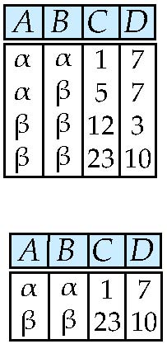
Select Operation – selection of rows (tuples)
Relation r
σ_{A=B ^ D > 5} (r)

Slide 10
Project Operation
Notation: where A₁, A₂ are attribute names and r is a relation name.
The result is defined as the relation of k columns obtained by erasing the columns that are not listed
Duplicate rows removed from result, since relations are sets
Example: To eliminate the dept_name attribute of instructor ∏_{ID, name, salary} (instructor)

Slide 11
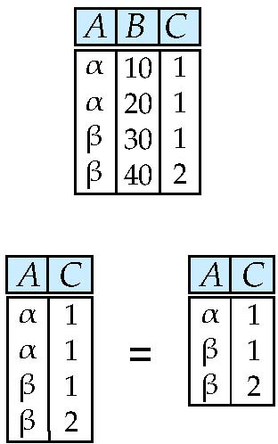
Project Operation – selection of columns (Attributes)
Relation r:
∏_{A,C} (r)

Slide 12
Union Operation
Notation: r ∪ s
Defined as:
r ∪ s = {t | t ∈ r or t ∈ s}
For r ∪ s to be valid.
1. r, s must have the same arity (same number of attributes)
2. The attribute domains must be compatible (example: 2nd column of r deals with the same type of values as does the 2nd column of s)
Example: to find all courses taught in the Fall 2009 semester, or in the Spring 2010 semester, or in both ∏_{course_id} (σ _{semester=“Fall” Λ year=2009} (section)) ∪ ∏_{course_id} (σ _{semester=“Spring” Λ year=2010} (section))

Slide 13
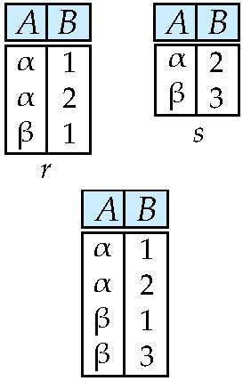
Union of two relations
Relations r, s:
r ∪ s:

Slide 14
Set Difference Operation
Notation r – s
Defined as:
r – s = {t | t ∈ r and t ∉ s}
Set differences must be taken between compatible relations.
r and s must have the same arity
attribute domains of r and s must be compatible
Example: to find all courses taught in the Fall 2009 semester, but not in the Spring 2010 semester ∏_{course_id} (σ _{semester=“Fall” Λ year=2009} (section)) − ∏_{course_id} (σ _{semester=“Spring” Λ year=2010} (section))

Slide 15
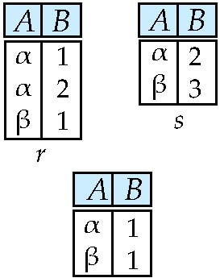
Set difference of two relations
Relations r, s:
r – s:

Slide 16
Set-Intersection Operation
Notation: r ∩ s
Defined as:
r ∩ s = { t | t ∈ r and t ∈ s }
Assume:
r, s have the same arity
attributes of r and s are compatible
Note: r ∩ s = r – (r – s)

Slide 17
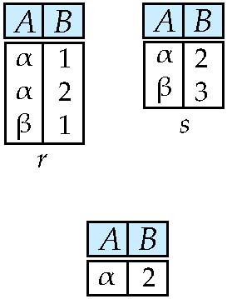
Set intersection of two relations
Relation r, s:
r ∩ s
Note: r ∩ s = r – (r – s)

Slide 18
Cartesian-Product Operation
Notation r x s
Defined as:
r x s = {t q | t ∈ r and q ∈ s}
Assume that attributes of r(R) and s(S) are disjoint. (That is, R ∩ S = ∅).
If attributes of r(R) and s(S) are not disjoint, then renaming must be used.

Slide 19
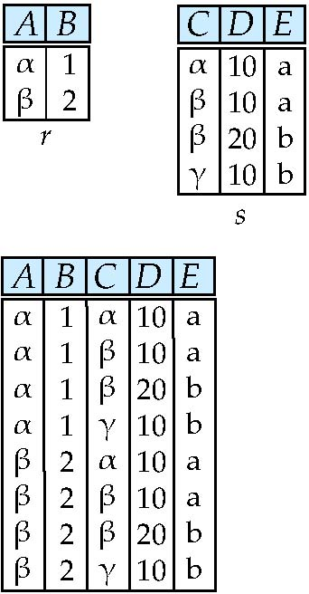
Joining Two Relations -- Cartesian-product
Relations r, s:
r x s:

Slide 20
Cartesian-product – naming issue
B
Relations r, s:
r.B
s.B
r x s:

Slide 21
Rename Operation
Allows us to name, and therefore to refer to, the results of relational-algebra expressions.
Allows us to refer to a relation by more than one name.
Example:
ρ _{x} (E)
returns the expression E under the name X
If a relational-algebra expression E has arity n, then
returns the result of expression E under the name X, and with the
attributes renamed to A₁ , A₂ , …., A_{n} .

Slide 22
Renaming a Table
Allows us to refer to a relation, (say E) by more than one name.
ρ _{x} (E)
returns the expression E under the name X
Relations r
r.A r.B s.A s.B
r x ρ _{s} (r)
α
α
β
β
1
1
2
2
α
β
α
β
1
2
1
2

Slide 23
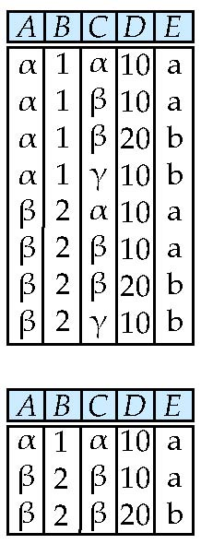
Composition of Operations
Can build expressions using multiple operations
Example: σ_{A=C} (r x s)
r x s
σ_{A=C} (r x s)

Slide 24
Joining two relations – Natural Join
Let r and s be relations on schemas R and S respectively. Then, the “natural join” of relations R and S is a relation on schema R ∪ S obtained as follows:
Consider each pair of tuples t_{r} from r and t_{s} from s.
If t_{r} and t_{s} have the same value on each of the attributes in R ∩ S, add a tuple t to the result, where:-
t has the same value as t_{r} on r
t has the same value as t_{s} on s

Slide 25
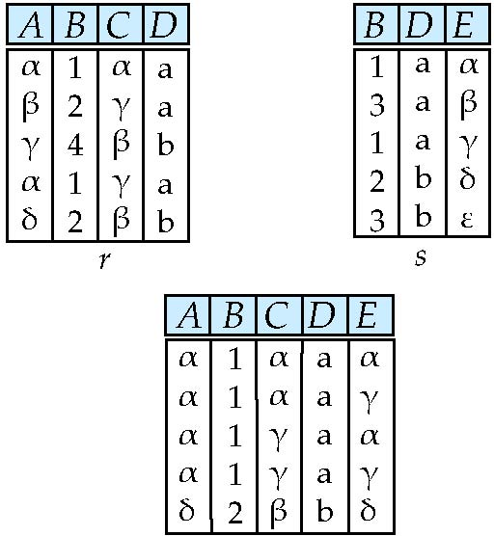
Natural Join Example
Relations r, s:
Natural Join
r s
∏ _{A, r.B, C, r.D, E} (σ _{r.B = s.B ˄ r.D = s.D} (r x s)))

Slide 26
Notes about Relational Languages
Each Query input is a table (or set of tables)
Each query output is a table.
All data in the output table appears in one of the input tables
Relational Algebra is not Turning complete
Can we compute:
SUM
AVG
MAX
MIN
Notes:
26

Slide 27
Summary of Relational Algebra Operators
Symbol (Name) Example of Use
σ
(Selection) ^{σ} salary > = 85000 ^{(instructor)}
Return rows of the input relation that satisfy the predicate.
Π
(Projection) ^{Π} ID, salary ^{(instructor)}
Output specified attributes from all rows of the input relation. Remove duplicate tuples from the output.
x
(Cartesian Product) instructor x department
Output pairs of rows from the two input relations that have the same value on all attributes that have the same name.
∪
(Union) ^{Π} name ^{(instructor) ∪ Π} name ^{(student)}
Output the union of tuples from the two input relations.
-
(Set Difference) ^{Π} name ^{(instructor)} ^{-- Π} name ^{(student)}
Output the set difference of tuples from the two input relations.
⋈
(Natural Join) instructor ⋈ department
Output pairs of rows from the two input relations that have the same value on all attributes that have the same name.

Slide 28
Formal Definition
A basic expression in the relational algebra consists of either one of the following:
A relation in the database
A constant relation
Let E₁ and E₂ be relational-algebra expressions; the following are all relational-algebra expressions:
E₁ ∪ E₂
E₁ – E₂
E₁ x E₂
σ_{p} (E₁), P is a predicate on attributes in E₁
∏_{s}(E₁), S is a list consisting of some of the attributes in E₁
ρ _{x} (E₁), x is the new name for the result of E₁

Slide 29
References
RamezElmasri and Shamkant B. Navathe, “Fundamentals of Database System”, The Benjamin / Cummings Publishing Co.
Korth and Silberschatz Abraham, “Database System Concepts”, McGraw Hall.
C.J.Date, “An Introduction to Database Systems”, Addison Wesley.
Thomas M. Connolly, Carolyn & E. Begg, “Database Systems: A Practical Approach to Design, Implementation and Management”, 5/E, University of Paisley, Addison-Wesley.

Slide 30
THANK YOU
For queries
Email: shaveta.e13464@cumail.in

